Slide 1

Professional Practices week 11,12
software liability

Slide 2
ERROR , FAULT, BUG, DEFECT, FAILURE
Error :- An error is a mistake made by a human (developer or coder) that leads to discrepancy between actual and expected result.
Fault :- Fault may occur in a software because it has not added the code for fault tolerance. It may occur because of :- Lack of resources, An invalid step, Inappropriate data definition.
Bug :- Logical Error is called Bug or flaw in a software system that causes the system to behave in an uninterrupted manner.
Defect :- A defect is a problem in the functioning of the software system during testing.
Failure :- When end user detects an issue in the product, then the particular issue is called a failure.

Slide 3
Software Liability
This means complex problem related to software
They cover the following areas:
- Complex application software defects - Operating system failures - On-line transaction processing (OLTP) performance issues - Distributed database issues

Slide 4
Complex application software defects (Bugs)
These include the following:-
Functional Bugs.
Logical Bugs.
Workflow Bugs.
Unit Level Bugs.
System-Level Integration Bugs.
Out of Bound Bugs.
Security Bugs.

Slide 5
Functional Bugs
These types of bugs are associated with the functionality of a specific software component.
For example:- a Login button doesn’t allow users to login, an Add to cart button that doesn’t update the cart, a search box not responding to a user’s query, etc.

Slide 6
Logical Bugs
These occur when computer gives wrong or misleading results or program crashes.
Logical bugs primarily take place due to poorly written code or wrong formulas in a computer program.
Example: Dividing two numbers instead of adding them together resulting in unexpected output.

Slide 7
Workflow Bugs
These are associated with the user journey (navigation) of a software application.
E.g. If a software prompts “Save and Exit” but when user clicks on it, the program exits without saving the file.

Slide 8
Unit Level Bugs
A program is divided into a number of modules linked together.
If any one of the module is not working properly, it is called Unit Level Bug.
e.g. When filling a form, we enter name, address, date of birth etc. The program does not validate date of birth properly.

Slide 9
System-Level Integration Bugs
These errors occur when two or more Programs written by different programmers fail to interact with each other.
It is due to not linking the programs properly.

Slide 10
Out of Bound Bugs
These errors show up when the end-user enters a value beyond the limit.
For example, entering a significantly larger or a smaller number beyond computer memory or entering an input value of an undefined data type.

Slide 11
Security Bugs
These occur when a developer adds restrictions regarding security of the software and they do not work.
E.g. A password is to be entered and checked by the system but the program does not check and anybody can enter the program.

Slide 12
Operating System Failures
An operating system failure means that the computer starts giving strange messages or hangs anywhere when running application programs.
Causes of Failures - Software Problems
- Hardware Problems

Slide 13
Operating System Failures (Software Problems)
OS is not properly installed as during installation we have to go through some critical questions and answers.
Other reasons may be malware or virus infections or unauthentic information transferred from the internet into our computer.

Slide 14
Operating System Failures ( Hardware Problems)
One of the storage devices is damaged.
A faulty power supply causes a system to shut down immediately
A bad processor makes it impossible for the computer to function properly.
Incorrect RAM chip may also stop working the OS properly.

Slide 15
On-line Transaction Processing (OLTP)
It is a type of data processing system that consists of executing a number of transactions using internet.
Examples:- - Online banking - Online shopping - Online order entry - Online admissions - Online job hunting - Sending and receiving messages etc.

Slide 16
On-line transaction processing (OLTP) performance issues
The need to handle hundreds, even thousands of simultaneous Users.
The need to allow many users to work on the same set of data, with immediate updating e.g. airline reservation system
The proper way to handle errors

Slide 17
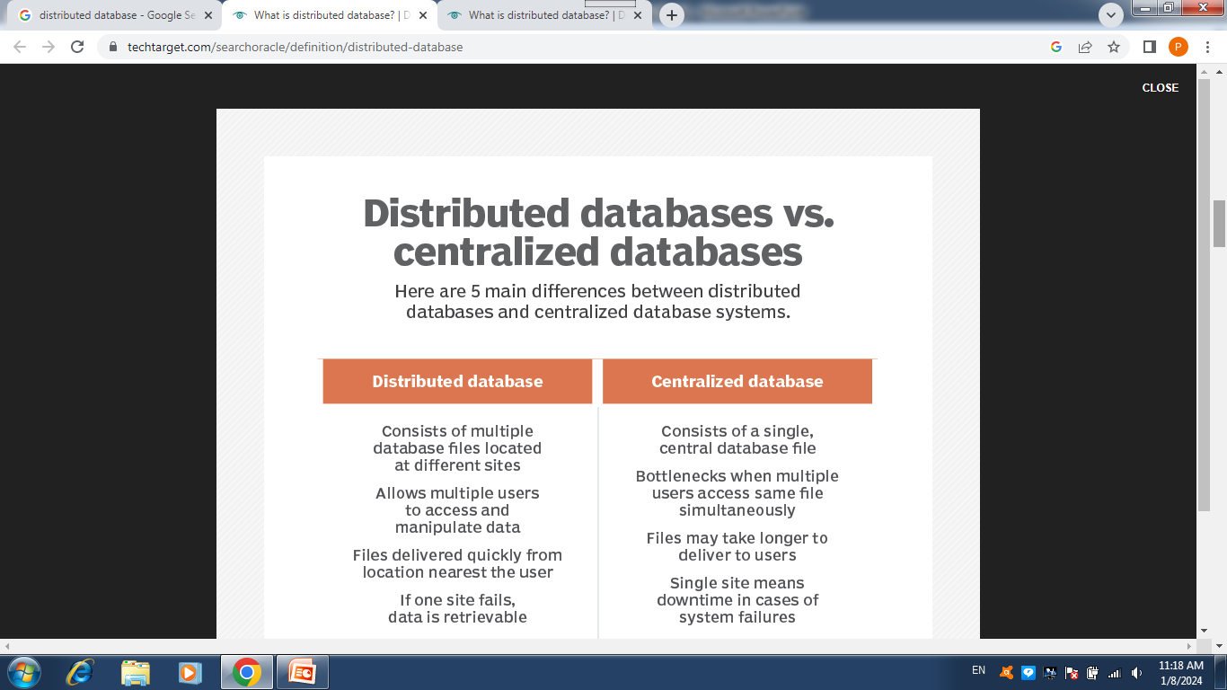
Distributed database issues

Slide 18
Examples of Distributed Database
In today's computing era, every large-scale service runs. On the cloud
in a distributed environment.
Facebook messages use a distributed database called Apache HBase to stream data to Hadoop clusters.
Youtube uses Kubernetes-aware cloud-native distributed database.
ByteGraph is a distributed graph database developed by ByteDance, the company behind the popular social network. TikTok.

Slide 19
END

